Slide 1


Number crunching the Games
The Olympic and Paralympic Games in numbers
Notes:
This fun, interactive multiple choice quiz will test your students knowledge of the Olympic and Paralympic Games. View in presentation mode to use the interactive features.

Slide 2
Match your facts
Read the questions below. For each question, click to match the correct number. If you are correct the number box will change colour to match the fact.
How many times have the Olympic and Paralympic Games have been held in South America?
3
How many times have the Paralympic Games have been held?
29
What is the number of Olympic Values?
1
How many gold medals did Team GB win at the London 2012 Olympic Games?
14
Notes:
In presentation mode the text and number in each boxes become clickable. Once clicked the box will change colour, allowing you or your students to match the corresponding pairs.

Slide 3
Match your facts…
Read the questions below. For each question, click to match the correct number. If you are correct the number box will change colour to match the fact.
Over how many days was the Rio 2016 Olympic Games held?
2
How many new sports were added to the Rio 2016 Olympic Games?
27
What is the number of Olympic Rings?
5
What number of World Records were broken by ParalympicsGB at the Rio 2016 Paralympic Games?
6
How many medals were won by ParalympicsGB at the Sochi 2014 Paralympic Winter Games?
17
Notes:
In presentation mode the text and number in each number boxes become clickable (look for the change in cursor before clicking). Once clicked the box will change colour, allowing you or your students to match the corresponding pairs.

Slide 4
Class quiz
Read the questions and select the correct answers
1. How many countries competed at the Rio 2016 Olympic Games?
2. How many Paralympic Values are there?
3. How many medal events were competed during the 1896 Olympic Games (the first modern Olympic Games)?
4. How many medal events were contested at the 2016 Olympic Games?
205
152
234
4
3
7
26
100
43
156
306
206
Notes:
In presentation mode, each of the multiple choice answers will change colour on click. (Green for the correct answer, red for incorrect).

Slide 5
Class quiz
Read the questions and select the correct answers
5. How many days long were the 2016 Paralympic Games?
6. How many competition venues were used for the 2008 Beijing Olympic Games?
7. How many countries competed at the first Paralympic Games in Rome, 1960?
16
19
17
37
26
19
54
83
23
Notes:
In presentation mode, each of the multiple choice answers will change colour on click. (Green for the correct answer, red for incorrect).

Slide 6
Class quiz
Read the questions and select the correct answers
8. How many tickets were available for the 2016 Paralympic Games events?
9. In what year were the Olympic Games were first held in London?
10. How many volunteers were needed to support the 2012 Olympic and Paralympic Games?
1.8 million
2.5 million
780,000
2012
1908
1948
200,000
70,000
90,000
Notes:
In presentation mode, each of the multiple choice answers will change colour on click. (Green for the correct answer, red for incorrect).

Slide 7
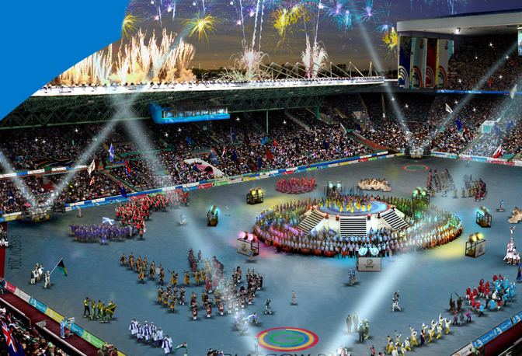
What was your score?
1 to 7
7 to 14
15 to 19
Notes:
Click on your score to receive your medal!

Slide 8
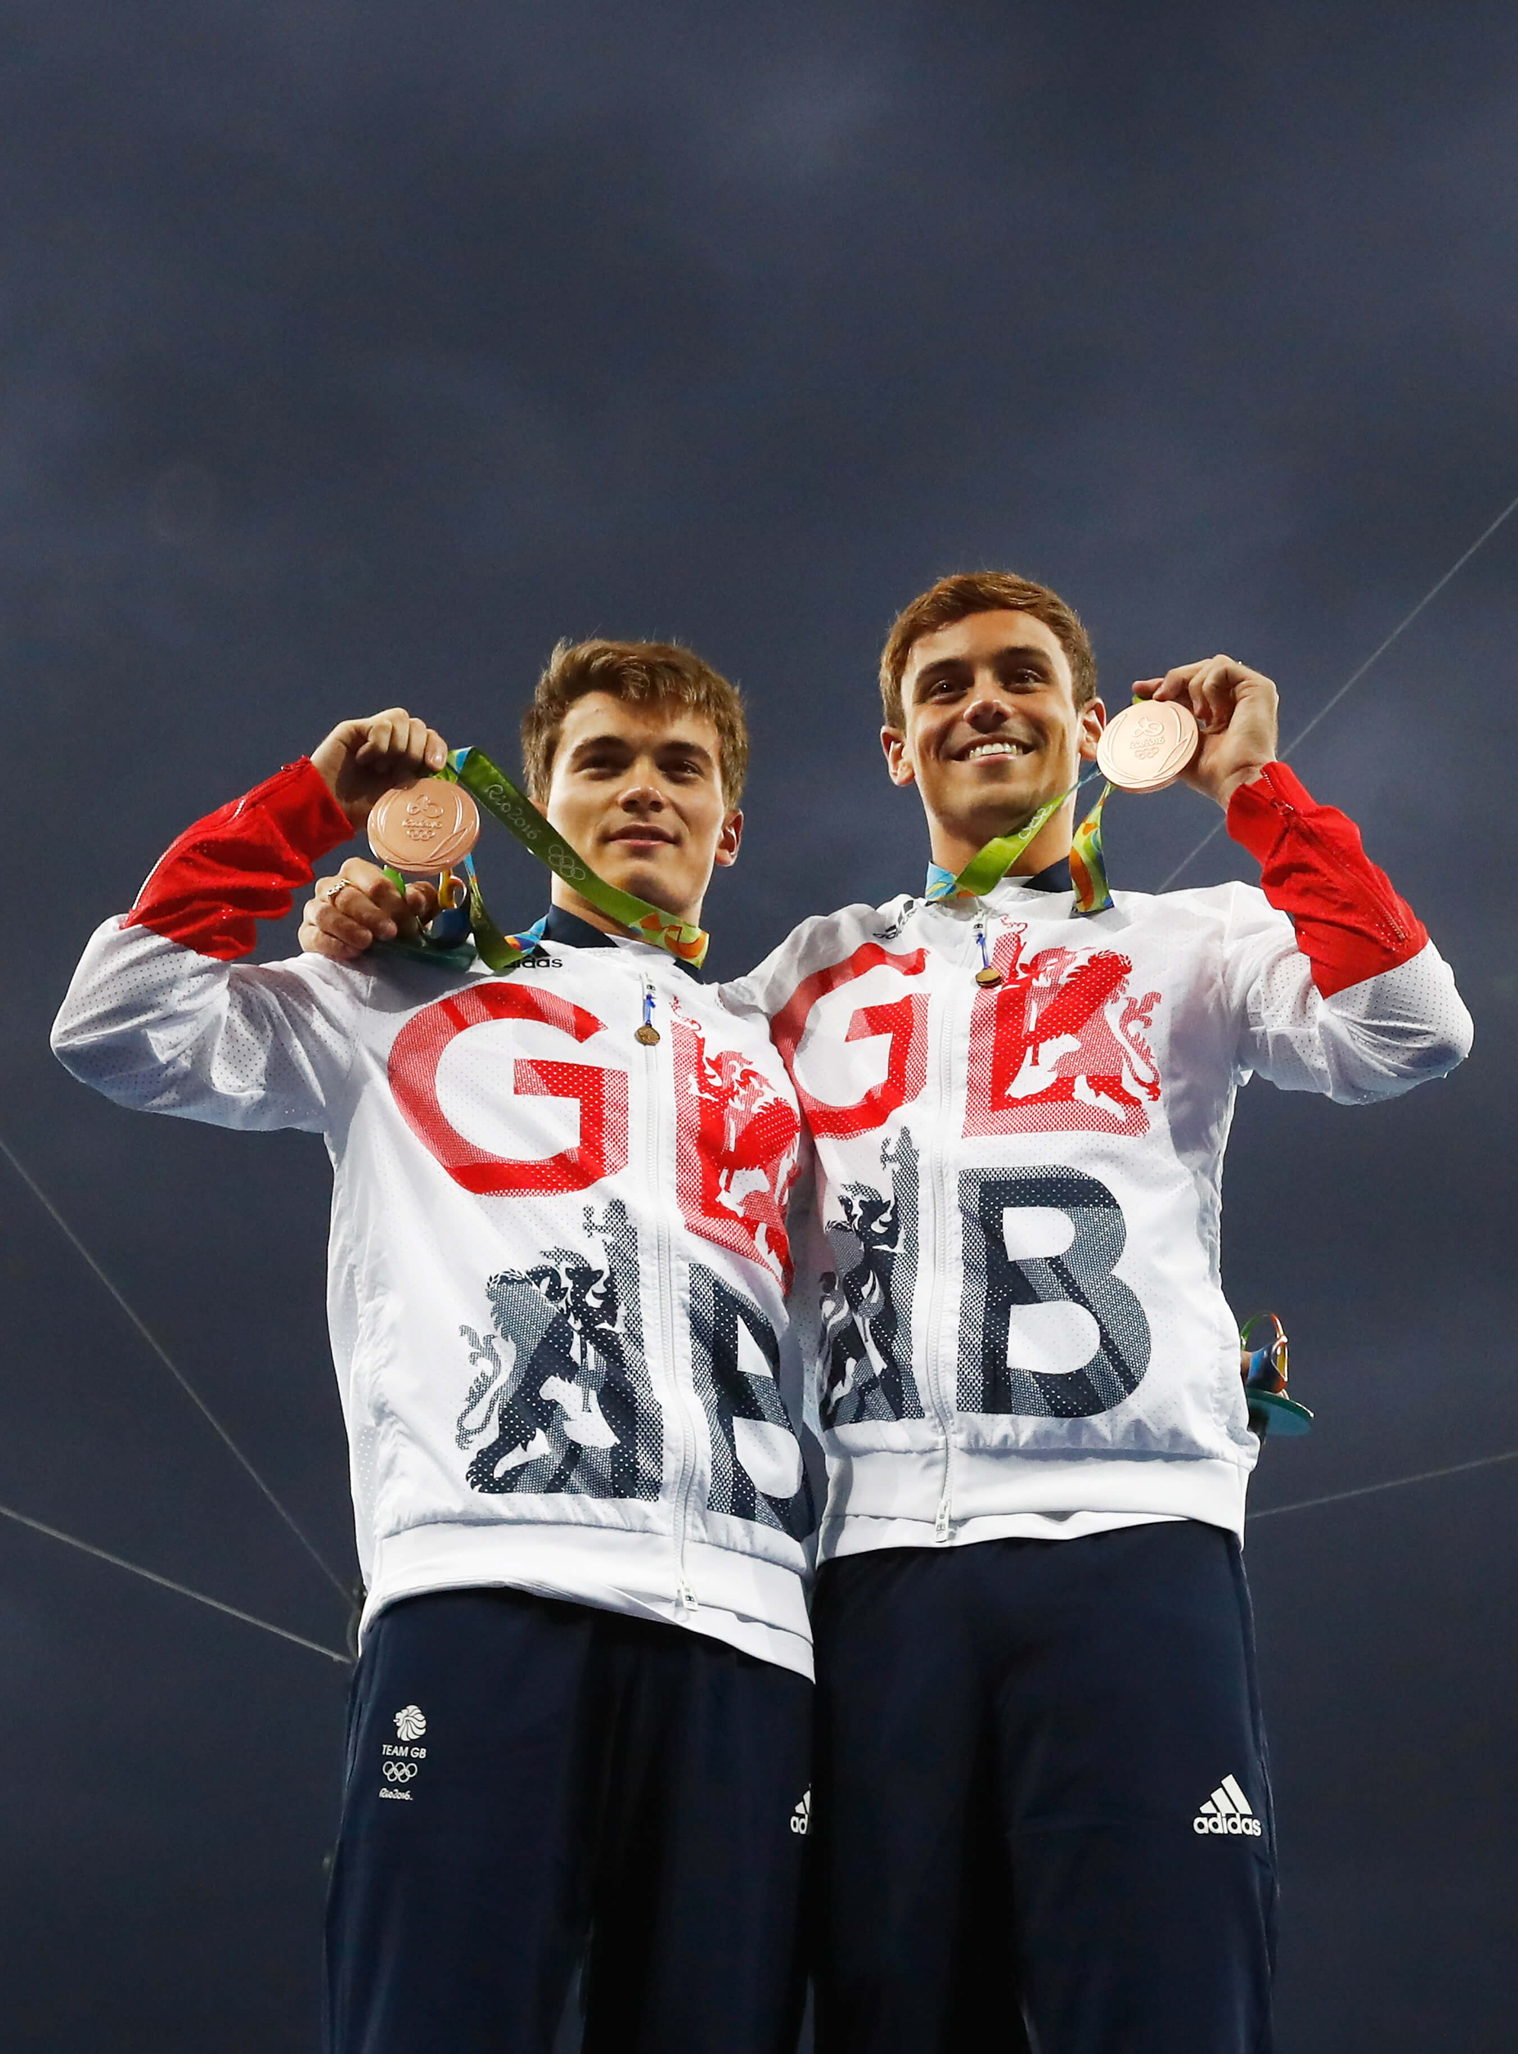
And the bronze medal goes to…
You’re off to a great start and learning more about the Olympic and Paralympic Games. Can you do even better next time?
Tom Daley and Daniel Goodfellow win bronze at Rio 2016.

Slide 9
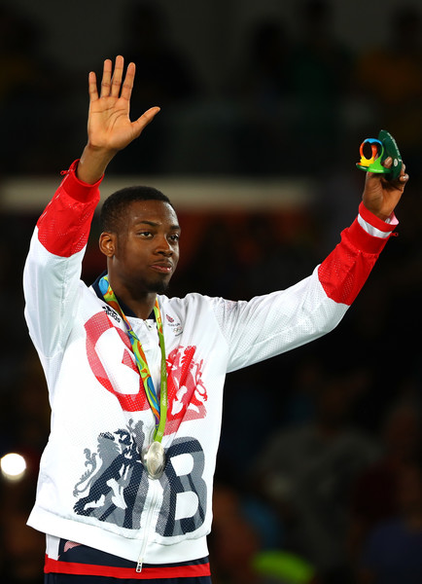
And the silver medal goes to…
Great work! You certainly know a lot about the Olympic and Paralympic Games. Next time go for gold!
Lutalo Muhammad wins silver in the men’s 80kg taekwondo final at Rio 2016

Slide 10
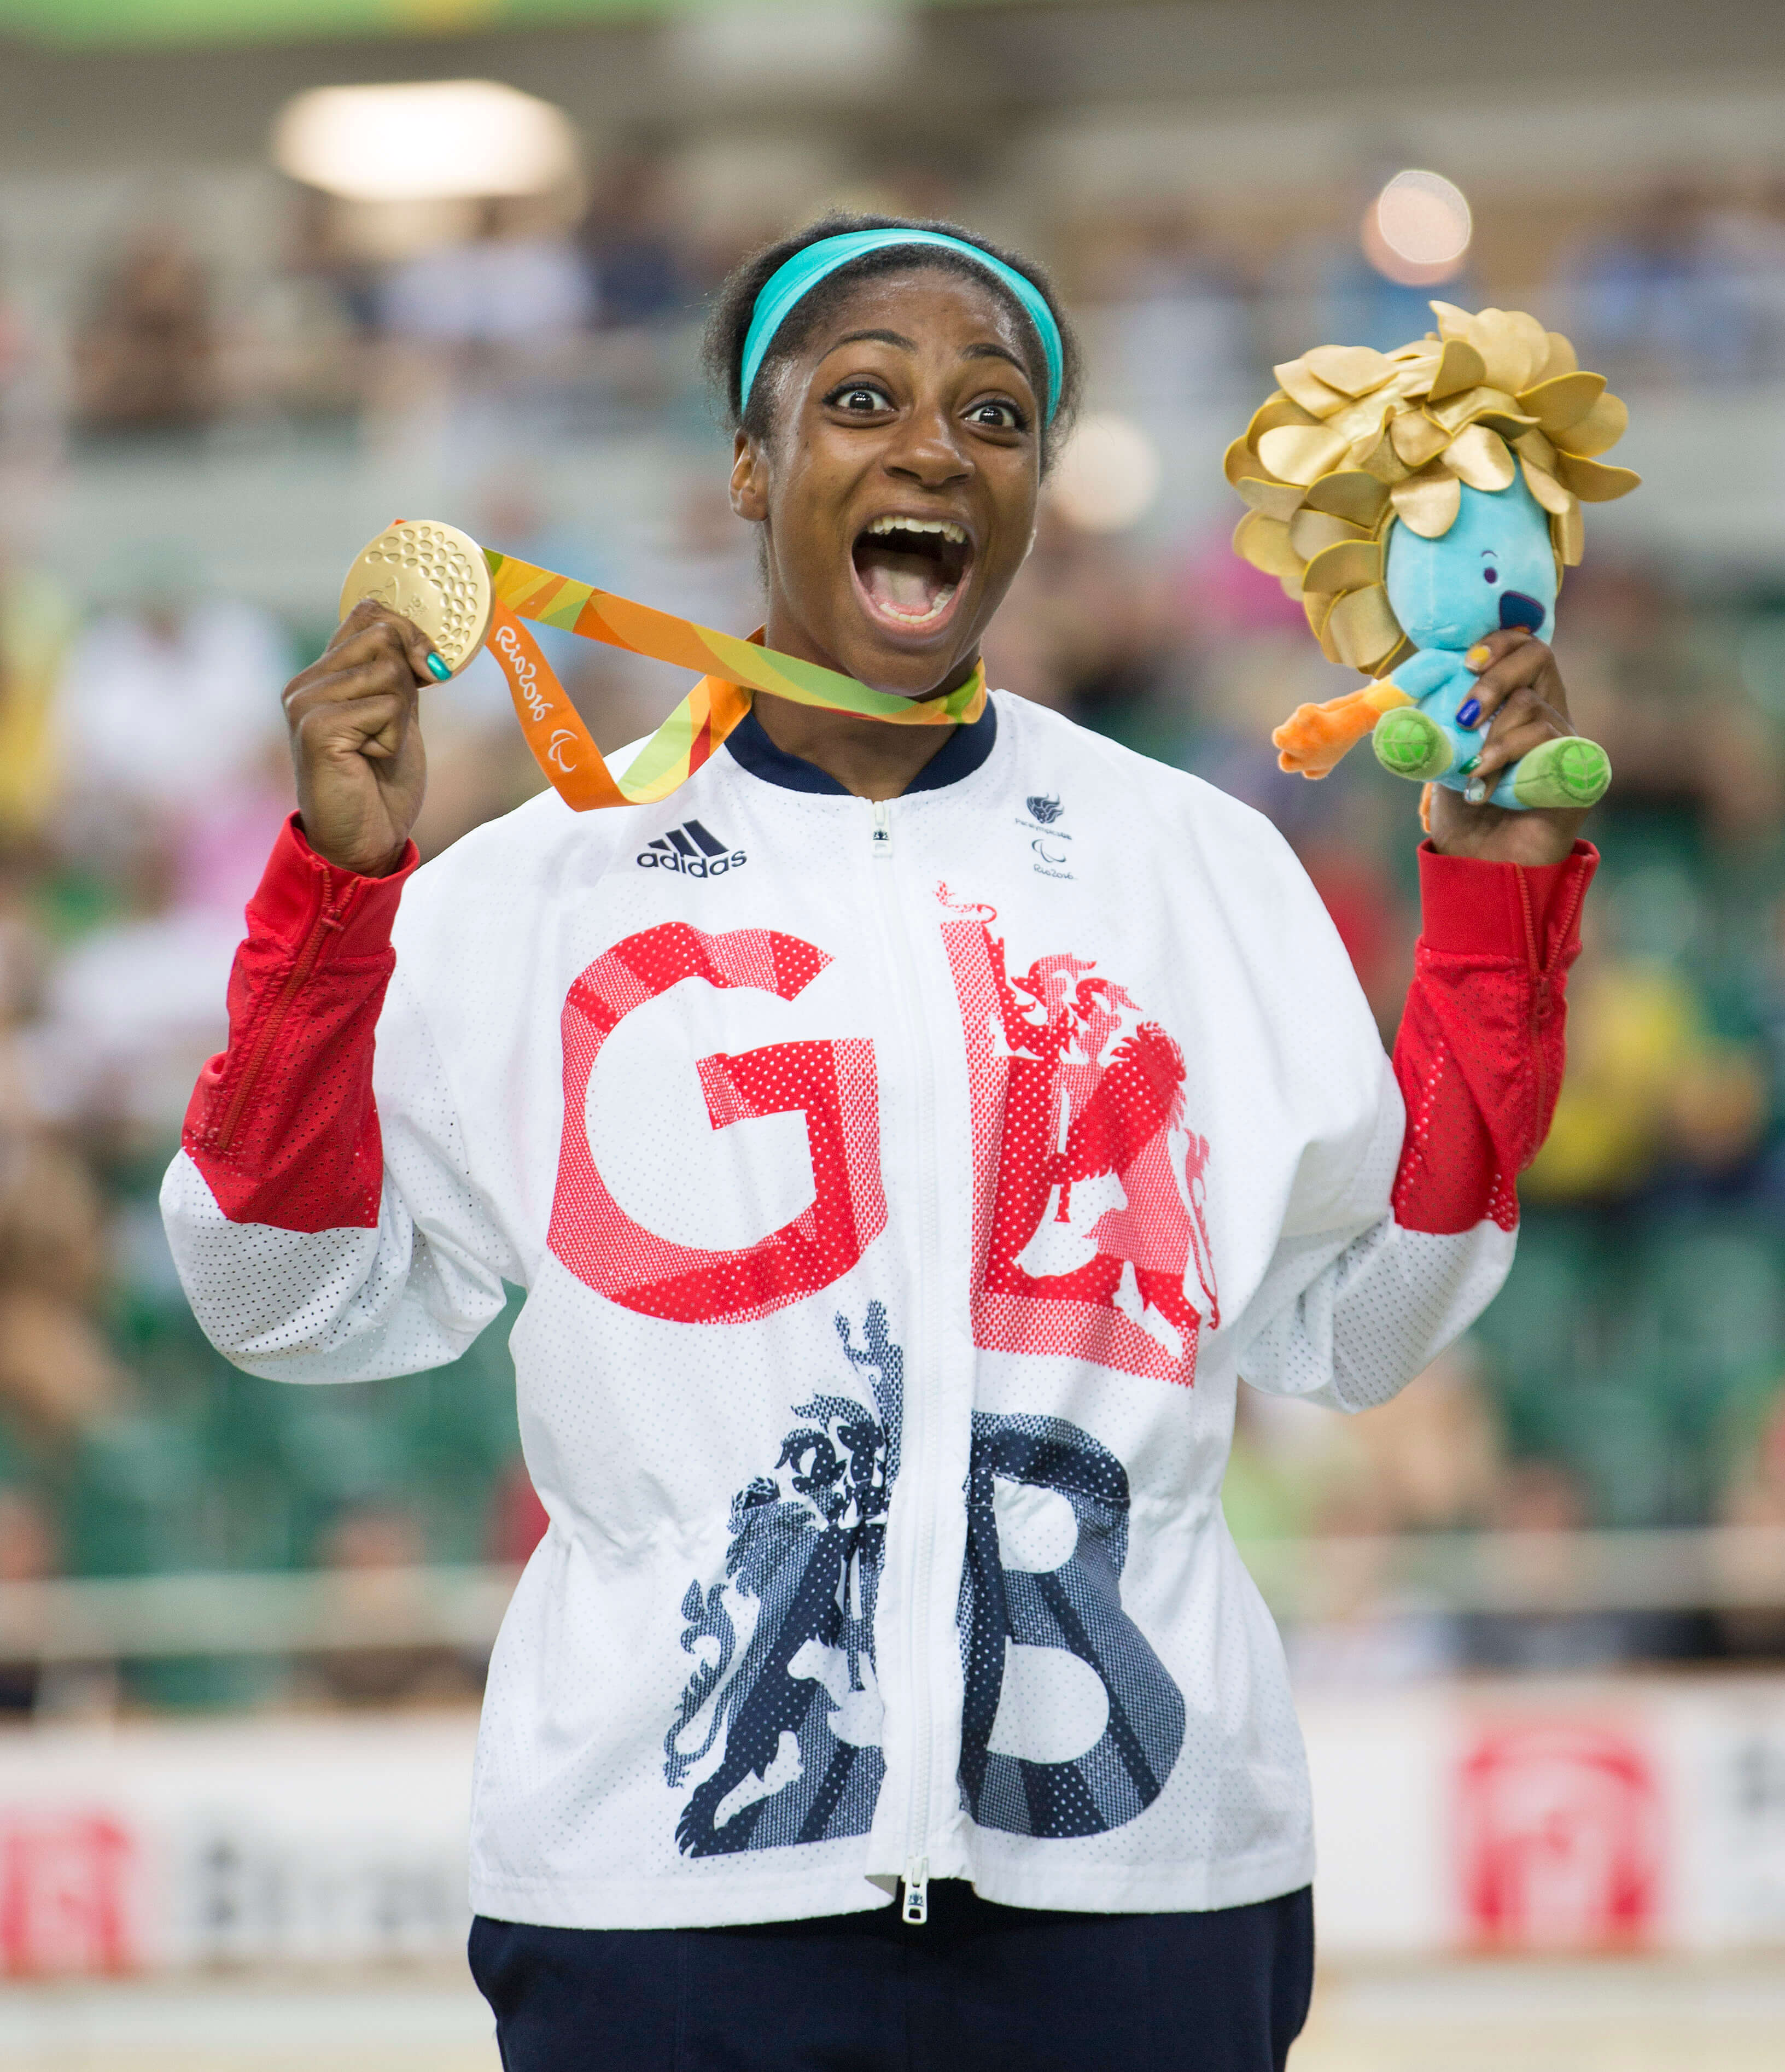
And the gold medal goes to…
Congratulations! You are definitely an Olympic and Paralympic Games expert. Keep watching Team GB and ParalympicsGB and Get Set for the next Olympic and Paralympic Games!
Kadeena Cox wins a cycling gold at Rio 2016

